Slide 1
File Handling

Slide 2
Introduction
File is a place where data/information is stored.
File handling means performing various operations on the file like opening the file , closing the file , deleting the file , reading the file, writing the file etc.

Slide 3
File Handling on Presentation Server
To work with files on presentation server, SAP provided the various function modules.
GUI_UPLOAD - Reading data from a file on presentation server.
GUI_DOWNLOAD - Writing data to a file on the presentation server

Slide 4
File Handling on Application Server
To work with files on application server SAP provided the below statements.
OPEN DATASET - Opens the specified file.
CLOSE DATASET - Closes the specified file.
DELETE DATASET - Deletes the specified file.
READ DATASET- Read a record from the file.
TRANSFER - Write a record in to a file.
Imp point : AL11 is the transaction code for SAP directories.

Slide 5
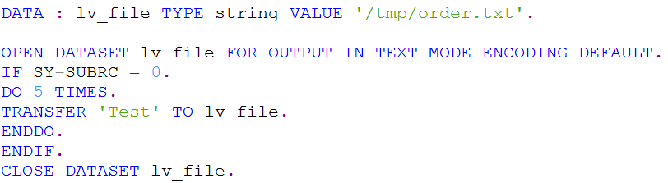
Writing Data to a File on Application Server
The below syntax writes data to the file '/tmp/order.txt’ on the application server.

Slide 6
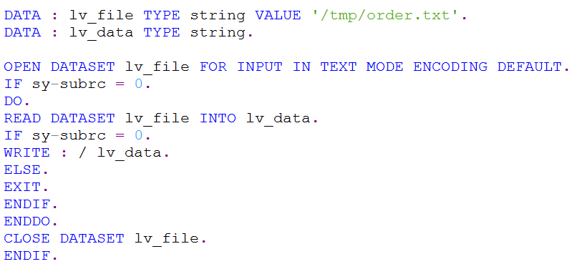
Reading Data from a File on Application Server
The below syntax reads the data from the file '/tmp/order.txt’ on the application server.

Slide 7
Archiving
Archiving is a concept by which we move the processed file to new folder(archive folder) on the application server and delete from the existing folder.
In future, in case of any need, we can retrieve the file from archive folder.

Slide 8
Thank You

